Slide 1
Text Analytics and NLP
- LKM Team

Slide 2

Meeting Agenda
Brief about Natural Language Processing (NLP)
Progress in NLP
Challenges in NLP
A bag of words approach
Cleaning Irregularities
Removing Unhelpful Terms : Stop Words
Stemming
5. Hands on Data
6. Examples of Text analytics

Slide 3
Brief about NLP
Natural Language processing (NLP):
It’s the field artificial intelligence which is focused on representing the natural language (such as human speech) in an algorithmic way so that the computer can understand the pattern of the language.
The goal is to understand and derive meaning from human language.
Using text as data:
Until now, our data has typically been Structured, Numerical, Categorical.
Textual data can be : Loosely structured, spelling error, non-traditional grammar and Colloquial language, Multilingual

Slide 4
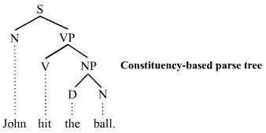
NLP
NLP
It depends on sequence of Words and are learned from data
P(Word1 , word2 …)
This models are based on Abstraction such as TREES & CATEGORY. These are Hand Coded rather than learning .
(e.g; NP , VP)
L(S1 , S2 …)
Probabilistic Word Based
Logical
Utilities
Language & Learning
Taggers like N GRAM
Classification
Gzip
Segmentation
Spelling Check
Bag of words : wordcloud, association rules
Language Translation
Sentiment analysis (hybrid)

Slide 5

NLP Progress
Initial focus on understanding grammar
Focus shifting now towards statistical,
machine learning techniques that learn
from large bodies of text .
Modern “artificial intelligences”:
Apple’s Siri and Google Now

Slide 6
Challenges in NLP
Computers need to understand text
• Ambiguity in context:
“I have put my bag in the car. It is large and blue”
“It = bag? It = car?
• Homonyms : US/us
• metaphors : “The snow is a white blanket ”
• Sarcasm : “Nice perfume! You must have marinated in it.”
• Negation using not “This movie is not good”
• Lack of Negation : “I liked your product as much as I like being poked in the eye with a stick”

Slide 7
A bag of words approach
The bag-of-words model is a simplifying representation used in natural language processing and information retrieval (IR). In this model, a text (such as a sentence or a document) is represented as the bag (multiset) of its words, disregarding grammar and even word order but keeping multiplicity.
Fully understanding text is difficult
Simpler approach: Count the number of times each words appears
“This place is great. I would recommend this place to my friends.”
This | place | is | great | I | would | recommend | to | my | friends
2 | 2 | 1 | 1 | 1 | 1 | 1 | 1 | 1 | 1

Slide 8
Bag of words: Simple but Effective
One feature for each word - a simple approach, but effective
Used as a baseline in text analytics projects and natural language processing
Not the whole story though - preprocessing can dramatically improve performance!

Slide 9
Cleaning Irregularities
Text data often has many inconsistencies that will cause algorithms trouble
Computers are very literal by default –
Great, great, GREAT will all be counted separately.
Change all words to either lower-case or upper-case
Loss of information : eg US, us -> us
Great | great | GREAT
1 | 1 | 1
great
3

Slide 10
Cleaning Irregularities
Punctuation also causes problems :
basic approach is to remove everything that isn’t a,b,…,z
Sometimes punctuation is meaningful
- Twitter: @amazon is a message to amazon
- “:(“, ”!!!” expresses negative sentiment
- Web addresses: www.randomwebsite.com/somepage.html
Should tailor approach to the specific problem
Great | ^great^ | GREAT!
1 | 1 | 1
great
3

Slide 11
Removing Unhelpful Terms : Stop words
Many words are frequently used but are only meaningful in a sentence - “stop words”
Examples: the, is, at, and,a,which… Unlikely to improve machine learning prediction quality
Remove to reduce size of data

Slide 12
Stemming
Do we need to draw a distinction between the following words?
argue argued argues arguing
• Could all be represented by a common stem, argu
• Algorithmic process of performing this reduction is called stemming
• Many ways to approach the problem

Slide 13
Stemming
plurals: dog and dogsCould build a database of words and their stems
Pro: handles exceptions
Con: won’t handle new words, bad for the Internet!
• Can write a rule-based algorithm
e.g. if word ends in “ed”, “ing”, or “ly”, remove it
Pro: handles new/unknown words well
Con: many exceptions, misses words like child and children (but would get other )

Slide 14
Data: Sentiment Mining on Amazon feedback
We have data which contains 1000 feedbacks from Amazon.com collected randomly and scored as 0 ( Negative) and 1 (Positive).
Challenge : Can we train a model to classify the feedbacks as positive and negative?

Slide 15
Introduction to R
Be motivated. R has a steep learning curve. Find a problem you can't solve otherwise. E.g. plotting multivariate data, a statistical analysis for which an R function exists already.
Download and install R. Get to know the R console. Learn how to install additional packages, how to access the history, how to use auto completion and open the help system. Review the R Installation and Administration manual and check out the free books section on CRAN.
Get familiar with the R help files. They can appear cryptic at the start, but there is a structure to them. Read and re-read a couple of help files again and again. Look out for the input and output sections, execute the examples, run the demos, e.g. demo(graphics). Subscribe to R-help and read questions and answers, check out stackoverflow, follow blogs. Search with Rseek.org.
Learn how to get your data into R. The easiest way is usually via a CSV-file (CSV=comma separated values), using read.csv. Look into XLConnect, if you have to deal with spreadsheet files. Move on to write queries against data bases, e.g. using RODBC. Skim through the R Data Import/Export manual.
Try to understand the different data types in R and how to modify them. What are the differences between a matrix and a data frame? What is a factor? What is a list? Think about the different use cases. Review the Introduction to R manual.

Slide 16
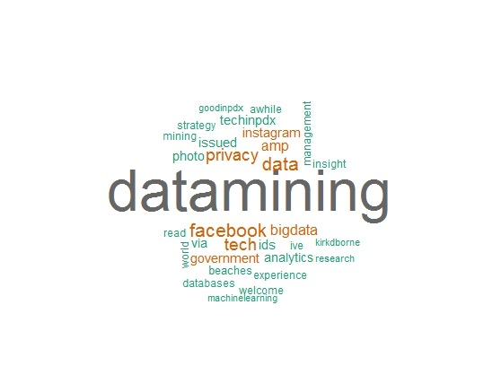
Word Cloud
Word cloud is a visual representation for text data, typically used to depict keyword metadata (tags) on websites, or to visualize free form text. Tags are usually single words, and the importance of each tag is shown with font size or color. This format is useful for quickly perceiving the most prominent terms and for locating a term alphabetically to determine its relative prominence. When used as website navigation aids, the terms are hyperlinked to items associated with the tag.
Copyright © 2012 Accenture All Rights Reserved.

Slide 17
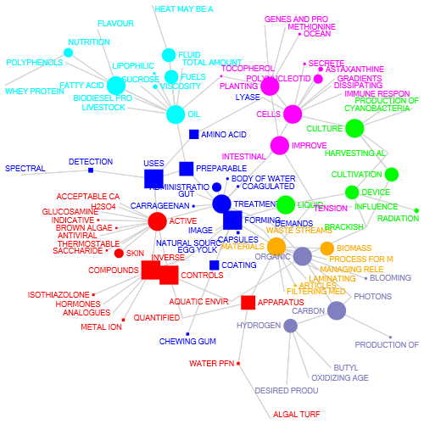
Text Clustering
Document clustering (or Text clustering) is automatic document organization, topic extraction and fast information retrieval or filtering. A web search engine often returns thousands of pages in response to a broad query, making it difficult for users to browse or to identify relevant information. Clustering methods can be used to automatically group the retrieved documents into a list of meaningful categories. There are two common algorithms. The first one is the hierarchical based algorithm, which includes single link, complete linkage, group average and Ward's method. By aggregating or dividing, documents can be clustered into hierarchical structure, which is suitable for browsing. However, such an algorithm usually suffers from efficiency problems. The other algorithm is developed using the K-means algorithm and its variants. Usually, it is of greater efficiency, but less accurate than the hierarchical algorithm.
Copyright © 2012 Accenture All Rights Reserved.

Slide 18
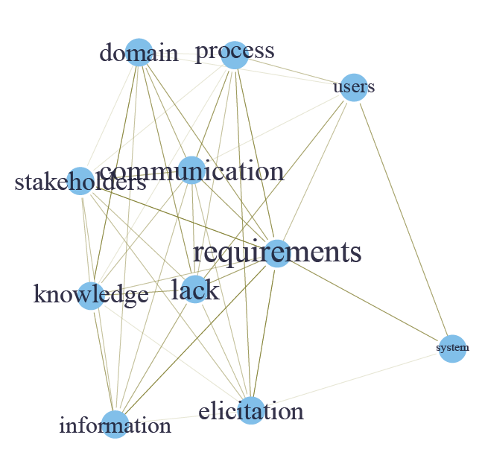
Association Analysis
Association analysis is the method of identification of associations or relationships among entities and information in text. It determines how closely a word (term) is associated with other words or sentences.
Copyright © 2012 Accenture All Rights Reserved.

Slide 19

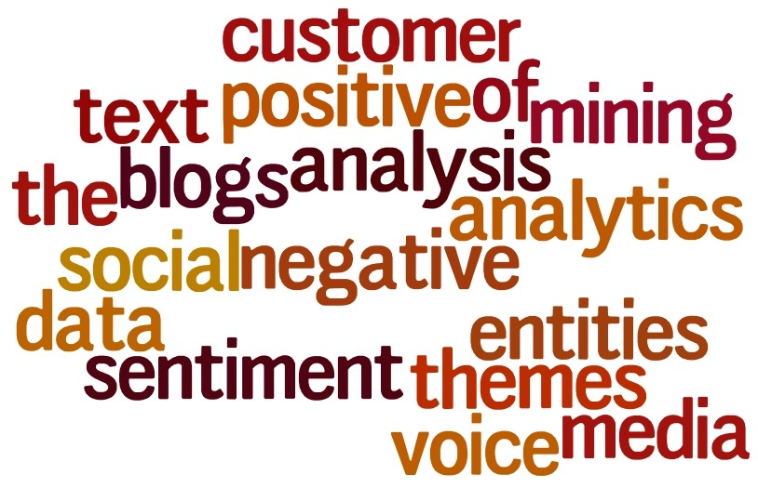
Sentiment Analytics
Sentiment analysis or opinion mining refers to the application of natural language processing, computational linguistics, and text analytics to identify and extract subjective information in source materials. Sentiment analysis aims to determine the attitude of a speaker or a writer with respect to some topic or the overall contextual polarity of a document. The attitude may be his or her judgment or evaluation, affective state (the emotional state of the author when writing), or the intended emotional communication (the emotional effect the author wishes to have on the reader).
Copyright © 2012 Accenture All Rights Reserved.

Slide 20
References
Sentiment Analytics with Twitter Data :
https://techtime.accenture.com/document/extraction-tweets
2. A Document on NLP Design based on N GRAM :
https://kx.accenture.com/repositories/contributionform.aspx?path=C33/47/69&mode=read

